Slide 1

Predicting the Prices of Used Cars in India
Tongling
AJ Zhao

Slide 2

the BIG PICTURE
There exists some used car price prediction systems online like Cars.com and Kelly Blue Book. Although these websites offer this service, their prediction method may not be the best.
We are curious about the logic and methodology behind these car valuation systems and what features are playing important roles in car residuals values as new models come out.
From an economic perspective, it is important to know their actual market value while buying-and-selling-asymmetric information may lead to inefficient market allocations.

Slide 3
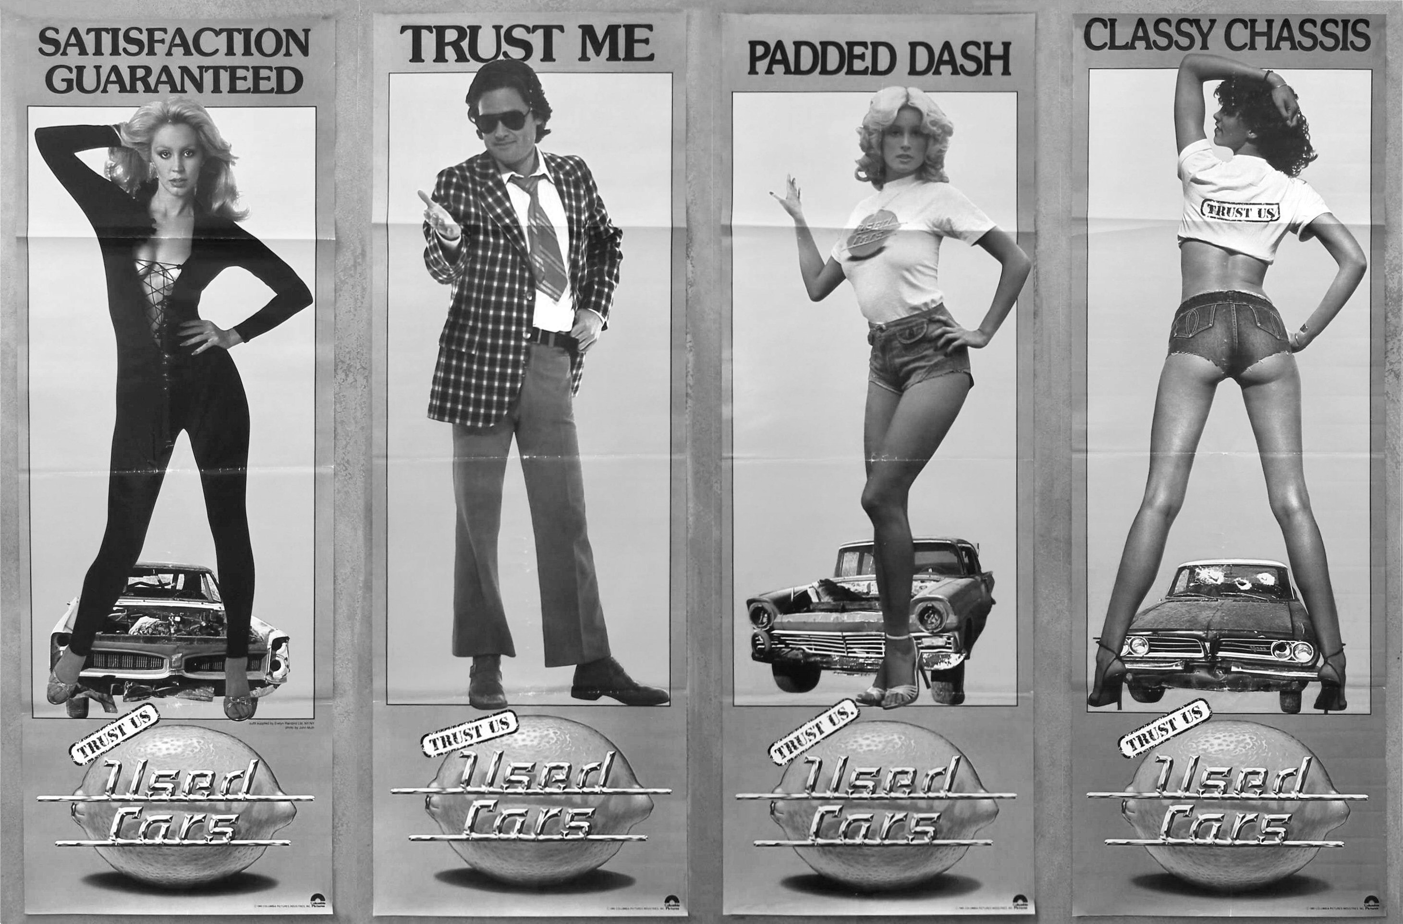
DATA Kaggle, Avwe Kasliwal
Challenges
The variable called “Names” contains too many details about the types of cars in each observation such as “Mahindra XUV500 W8 2WD.” (2000+ variables after dummy) ——> “substr” (substring) select first four letters as the car brands’ names (ex. Merc stands for Mercedes-Benz)
The variable “Mileage” contains different fuel efficiency (kmpkg and kmpL) for traditional fossil fuel (petrol and diesel) and new energy fuel (LPG and CNG). ——> “ifelse” function to classify this variable into two different variables.
Cleaning
To numeric: as.numeric
Missing value: knnImpute
Standardize: center scale
Character: dummy variable

Slide 4
Models
Lasso & Ridge
The tuned parameter lambda is shrinkage penalty for adding variables
5-fold cv
Boosting
Three tuning parameters: the number of trees to prevent the model overfitting
The interaction depth-determine tree’s complexity
The shrinkage parameter- learning rate
5-fold cv for tuning parameters.
Linear
No tuned parameter
cross validation with fold of 10
Random Forest
The tuned parameters are the number of predictors at each split and the size of node
The method for tuning that we choose is out-of-bag error
The spit rule is “extratrees”(regression outcome)

Slide 5
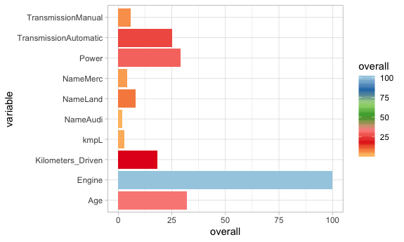
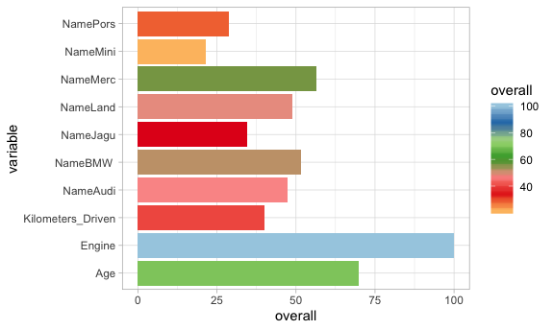
Models
Boosting variable importance
Lasso variable importance

Slide 6
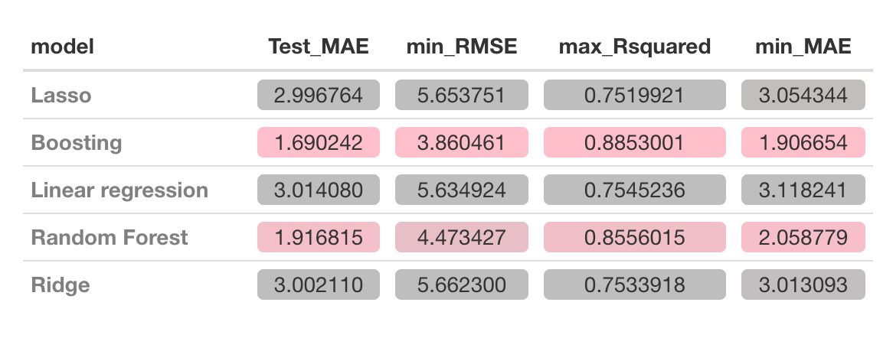
Results and conclusion

Slide 7
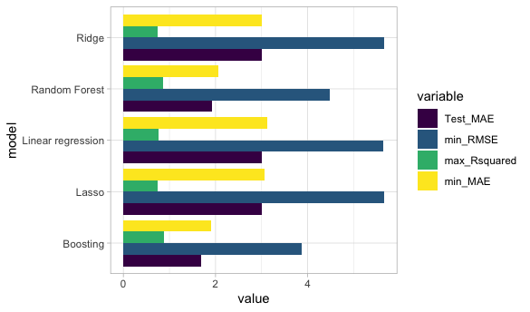
Results and conclusion

Slide 8
THANKS AND HAPPY SPRING BREAK ☺

